Slide 1
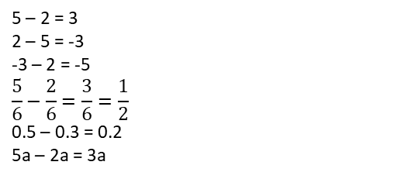
Subtopic N2.7 – Use Formal Methods for Subtraction of Decimals
LEARNING OUTCOME: To understand how to subtract integers.
Keywords:
Subtract
Difference
Exchange
Objectives:
To use the column method for subtraction involving decimals.
To use the column method for subtraction involving decimals and exchanging.
Introduction – Read and annotate:
When subtracting decimals, you follow the same steps as adding decimals: line up the decimal points
so that digits with the same place value are aligned. You can also add zeros as placeholders to make
the numbers the same length. Once lined up, subtract each column starting from the right, just as
you would with whole numbers.
Definition
Characteristics
A mathematical operation in which the difference between two numbers or quantities is calculated.
• Can involve positive or negative integers, fractions, decimals, percentages or algebraic terms.
• Linked words include minus, difference.
Examples
Subtraction
Non - Examples
Words that aren’t linked to subtraction:
• Sum: When you're asked to find the "sum" of numbers, you're being asked to add them, not subtract. For example, the sum of 8 and 6 is 14, which is not a subtraction
• Compare: When comparing numbers to determine which is larger or smaller, you are not performing a subtraction. For example, comparing 10 and 5, you know that 10 is greater, but this doesn't involve a subtraction operation
Column subtraction with decimals, no exchanging
For the following questions, use the column method to work out the subtraction problems:
Steps | 3.8 − 2.5 | 1.8 − 0.6 | 8.7 − 1.3
1) Write the numbers in columns, ensuring that they are lined up correctly (keep the decimals in line.
2) Starting from the right, complete subtraction.
Example 1 - I do…
Example 2 – We do…
Example 3 – You do…
1.3
1.2
7.4

Slide 2
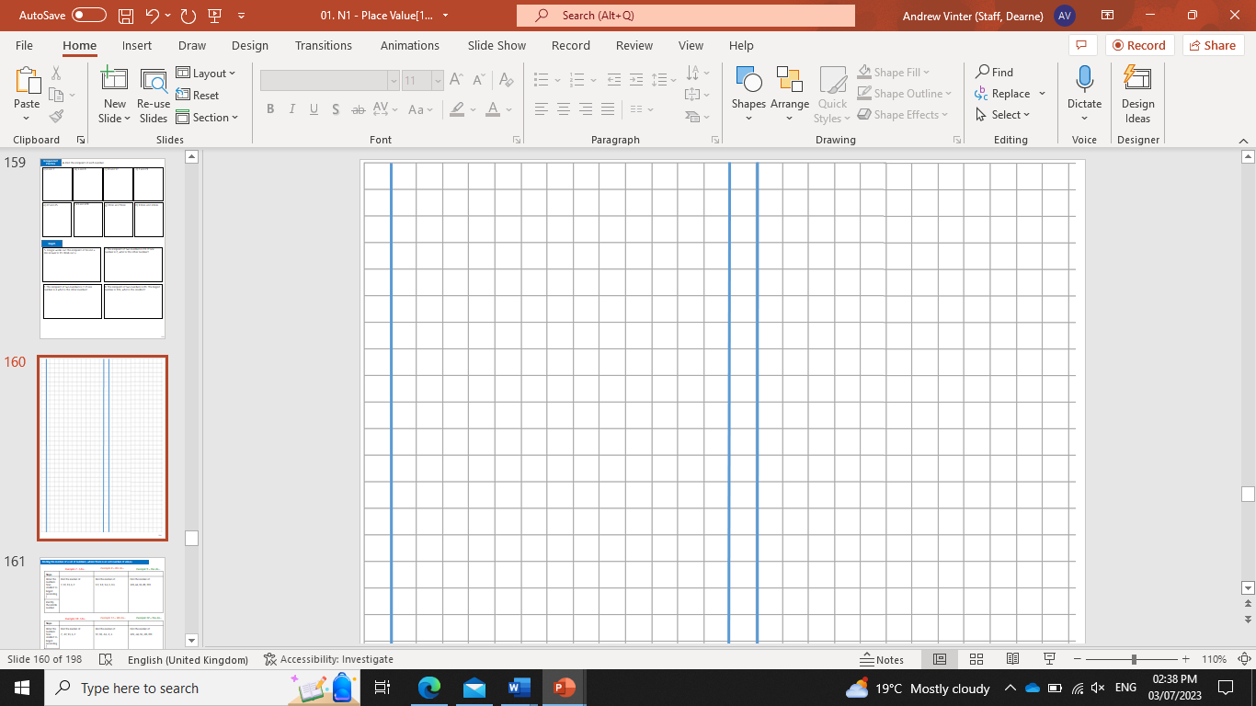
For the following questions, use the column method to work out the subtraction problems:
Steps | 45.93 – 3.4 | 37.81 – 6.2 | 84.95 – 4.5
1) Write the numbers in columns, ensuring that they are lined up correctly (keep the decimals in line.
2) Starting from the right, complete subtraction.
Example 4 - I do…
Example 5 – We do…
Example 6 – You do…
42.53
31.61
80.45
Independent Practice
1. For the following questions, use the column method to work out the subtraction problems:
a) 4.6 – 1.2 | b) 8.9 – 2.5 | c) 7.3 – 3.1
d) 6.8 – 0.7 | e) 5.4 – 2.1 | f) 9.7 – 4.3
g) 4.56 – 2.34 | h) 7.89 – 3.45 | i) 6.78 – 1.32
3.4
6.4
4.2
6.1
3.3
5.4
2.22
4.44
5.46
j) 9.45 – 6.21 | k) 3.69 – 2.17 | l) 8.53 – 4.41
3.24
1.52
4.12

Slide 3
2.
a) 3.67 – 2.1 | b) 8.53 – 4.1 | c) 6.32 – 1.2
d) 9.45 – 6.2 | e) 4.238 – 1.21 | f) 7.892 – 1.2
g) 5.643 – 2.1 | h) 7.932 – 1.21 | i) 2.999 – 1.2
j) 7.565 – 0.44 | k) 9.6897 – 7.23 | l) 18.49723 – 4.35
1.57
4.43
5.12
3.25
3.028
6.692
3.543
6.722
1.799
7.125
2.4597
14.14723
Column subtraction with decimals, involving exchanging
For the following questions, use the column method to work out the subtraction problems:
Steps | 5.54 – 0.36 | 5.45 – 0.27 | 4.55 – 0.39
1) Write the numbers in columns, ensuring that they are lined up correctly.
2) Starting from the ones column, complete subtraction.
3) Exchange where appropriate.
Example 7 - I do…
Example 8 – We do…
Example 9 – You do…
5.18
5.18
4.16

Slide 4
For the following questions, use the column method to work out the subtraction problems:
Steps | 5.54 – 0.036 | 5.45 – 0.027 | 4.55 – 0.039
1) Write the numbers in columns, ensuring that they are lined up correctly.
2) Starting from the ones column, complete subtraction.
3) Exchange where appropriate.
Example 10 - I do…
Example 11 – We do…
Example 12 – You do…
5.504
5.423
4.511
a) 3.56 – 0.35 | b) 3.56−0.36 | c) 3.56−0.37
d) 3.56−0.47 | e) 3.56−0.57 | f) 3.56−0.057
g) 3.56−0.507 | h) 3.56 – 0.35 | i) 3.55−0.35
j) 3.54−0.35 | k) 3.46−0.35 | l) 3.36−0.35
Independent Practice
3. For the following questions, use the column method to work out the subtraction problems:
3.21
3.20
3.19
3.09
2.99
3.503
3.053
3.21
3.20
3.19
3.11
3.01

Slide 5
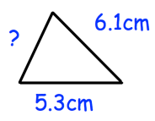


m) 0.366−0.35 | n) 0.666−0.35 | o) 3.56 – 0.35
0.016
0.316
3.21
p) 3.56−0.30 | q) 3.57−0.31 | r) 3.55−0.29
s) 4.15−0.89 | t) 8.3−1.78 | u) 0.83−0.178
4. Jennifer has 1.2kg of flour. She uses 0.75kg of the flour to bake a cake. How much flour is left?
3.26
3.26
3.26
3.26
6.52
0.652
0.45kg
5. The sides on the following triangle sum to 16.1 cm. Work out the length of the missing side.
4.7cm
6. For the following questions, find the missing numbers.
16.59
15.38

Slide 6
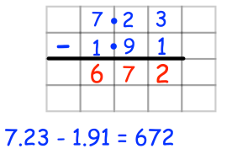
7. Angus is working out 7.23 − 1.91 . Can you spot any mistakes?
In the tenths column, Angus subtracted 2 from 9, rather than exchanging to make twelve tenths and subtracting 9 from that.
The complement of a decimal
For the following questions, work out the subtraction problems:
Steps | 1 – 0.32 | 1 – 0.57 | 1 – 0.47
1) Write the numbers in columns, ensuring that they are lined up correctly.
2) Starting from the right column, complete subtraction.
3) Exchange where appropriate.
Example 13 - I do…
Example 14 – We do…
Example 15 – You do…
0.68
0.43
0.53
Independent Practice
8.
a) 1 – 0.5 | b) 1 – 0.3 | c) 1 – 0.7
d) 1 – 0.25 | e) 1 – 0.43 | f) 1 – 0.78
g) 1 – 0.123 | h) 1 – 0.345 | i) 1 – 0.678
0.5
0.7
0.3
0.75
0.57
0.22
0.877
0.655
0.322
‹#›

Slide 7
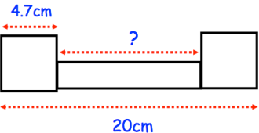
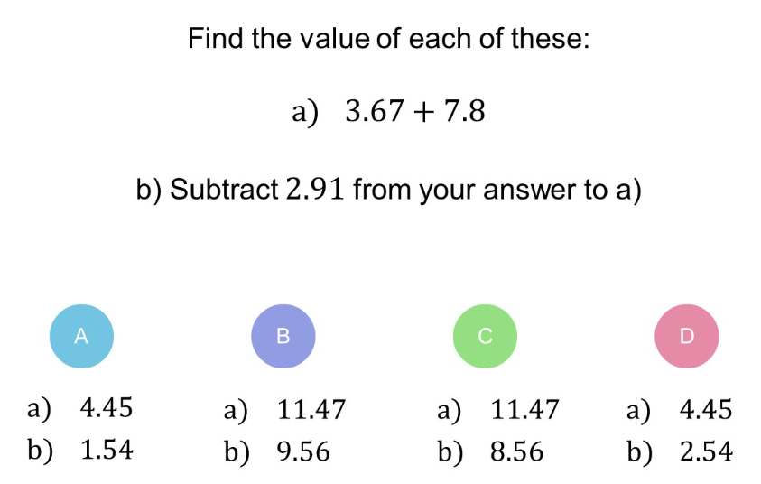


9. Two identical squares and a rectangle are drawn below. Find the length of the rectangle.
10.6cm
Skills Check
1.
2.
Calculate 1 – 0.56
1.56
44
0.54
0.44

